Slide 1
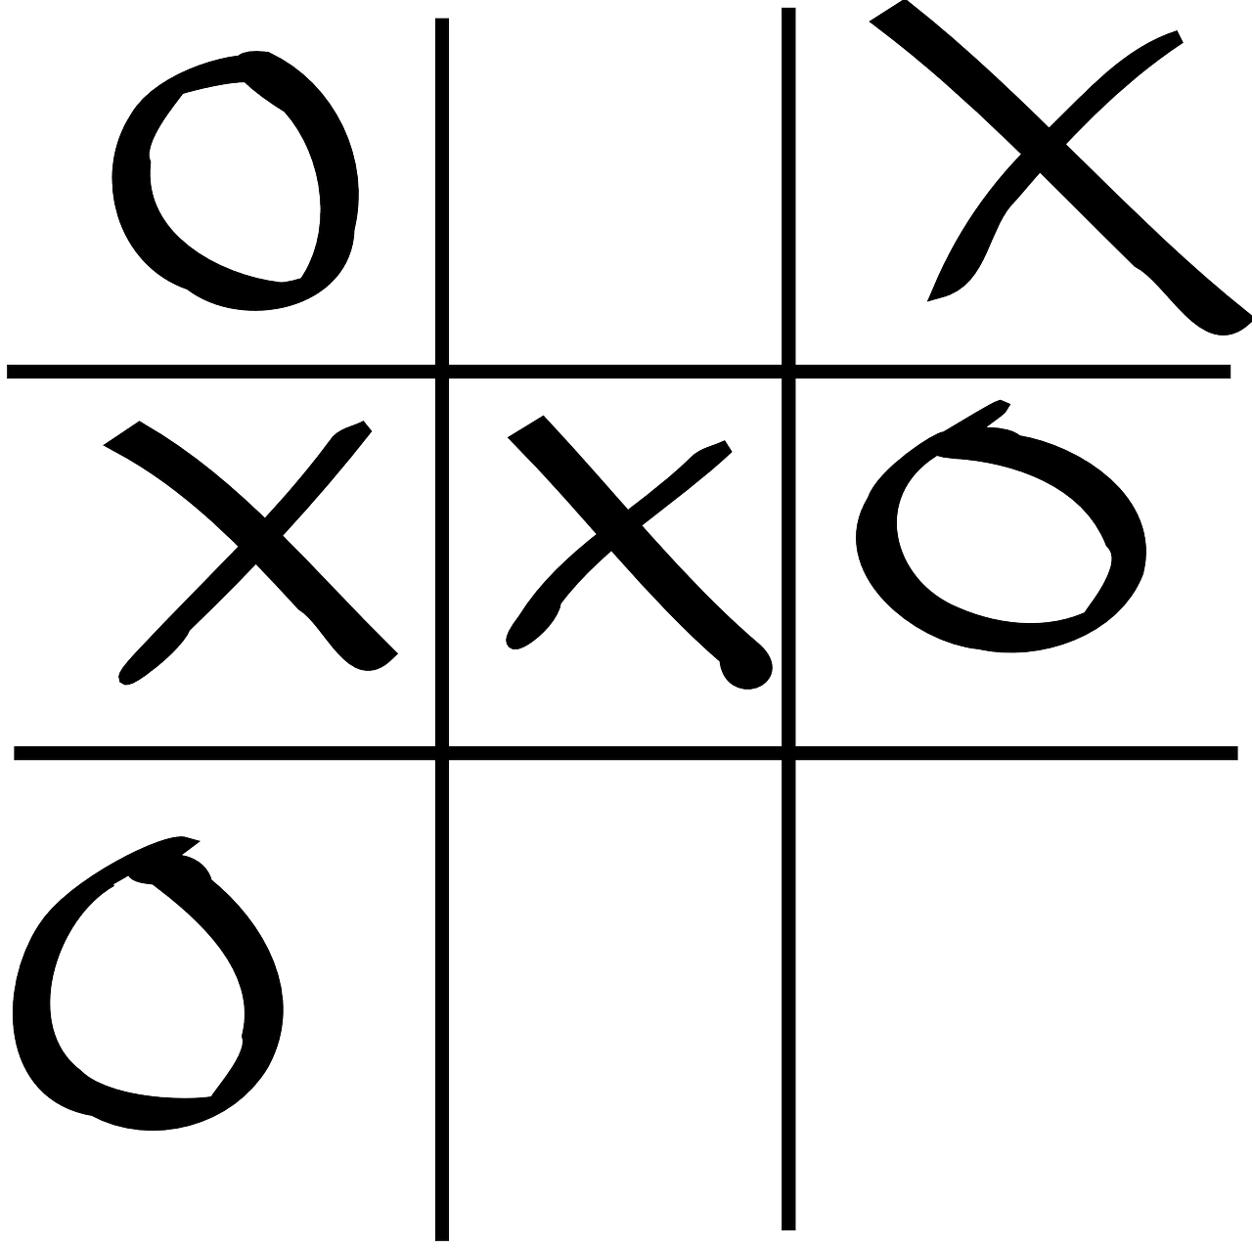
TIC TAE TOE
FINAL PROJECT
-By Priyanshu Verma

Slide 2
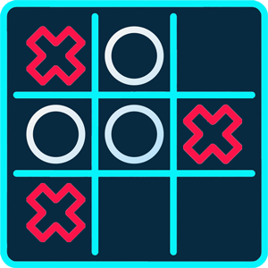
Introduction
Written in java programming language.
This java project is based on GUI board-based game..
All the gaming rules are the same.
Reduces the manual struggle to play this game.
This will provide lots of TIC TAC TOE matches without any error.

Slide 3
Implementation methodology:
A hash shape square board grid.
One of the players has to choose, 'O' and the other, 'X' to mark their respective cells.
The player will have to input a numerical character, from 1 to 9, to select a position for X or O into the space.
The game ends when one whole row/column/ diagonal filled with his/her respective character ('O' or 'X').
If the blank spaces in the grid are all filled, and there is no winner, then the game is said to be a draw.

Slide 4
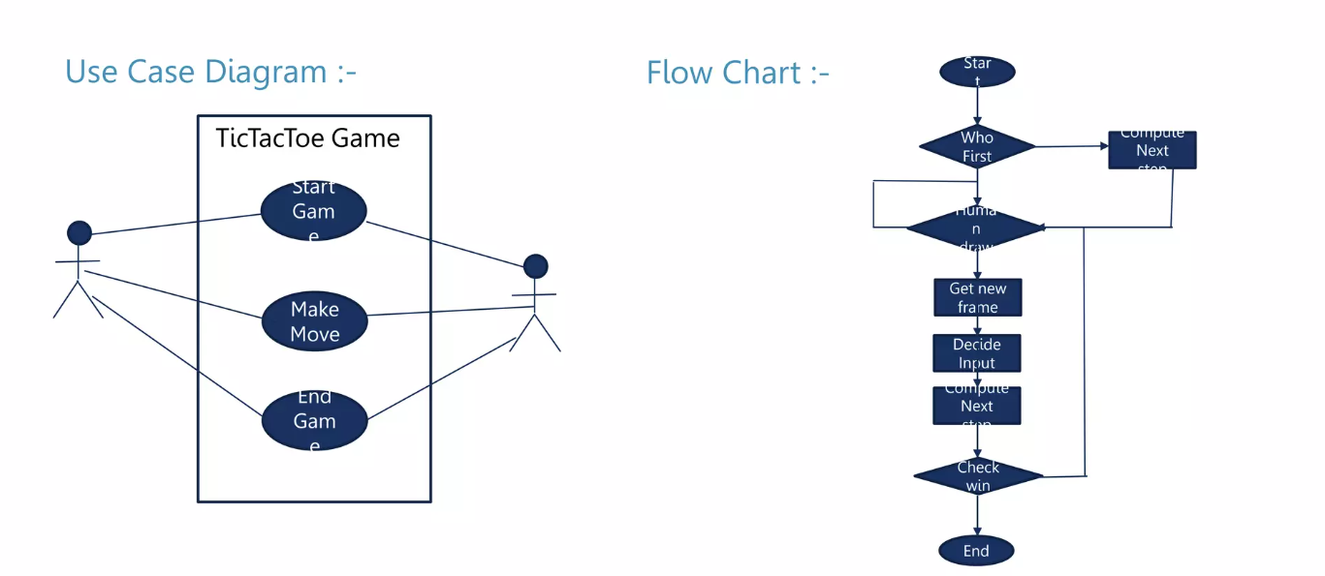
System design:

Slide 5
uses
Teaches strategy skills.
Improves the ability to concentrate and focus.
Helps to deal with cognitive decline.
Develops logical thinking.
Sets the foundation for learning more complex games.

Slide 6
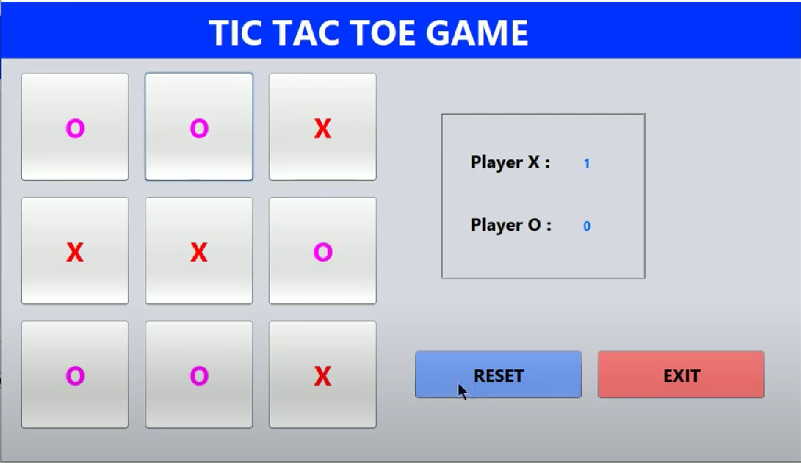
Interface

Slide 7
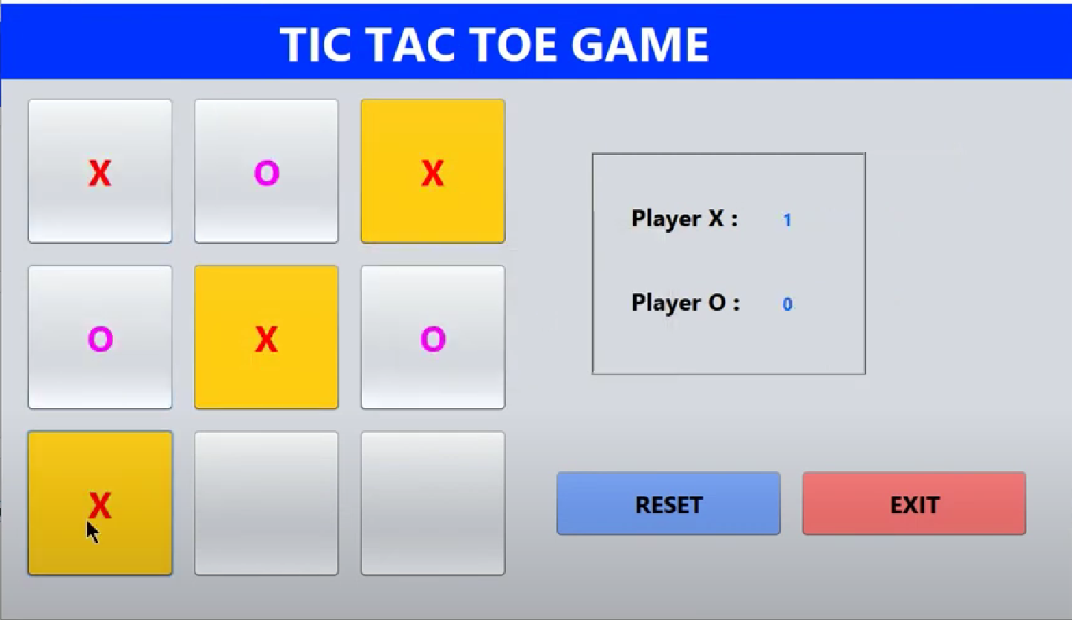
Interface

Slide 8
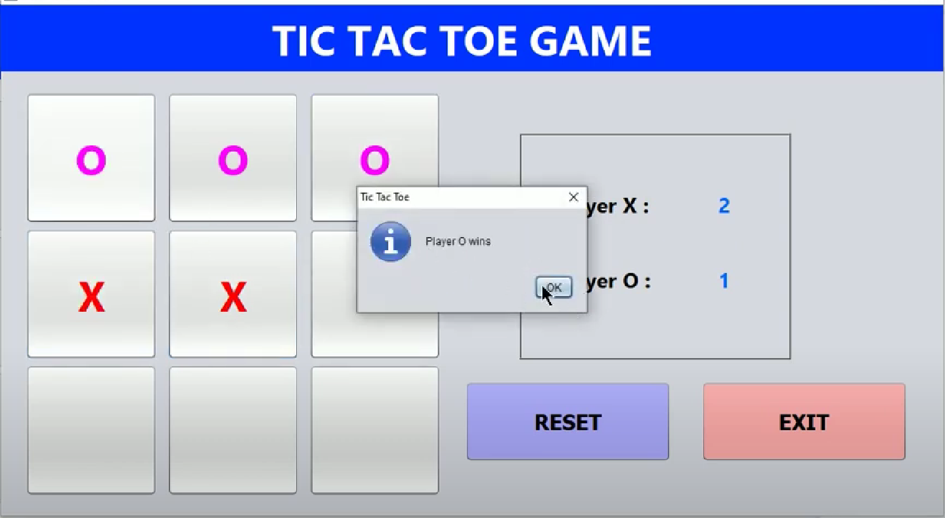
Interface

Slide 9
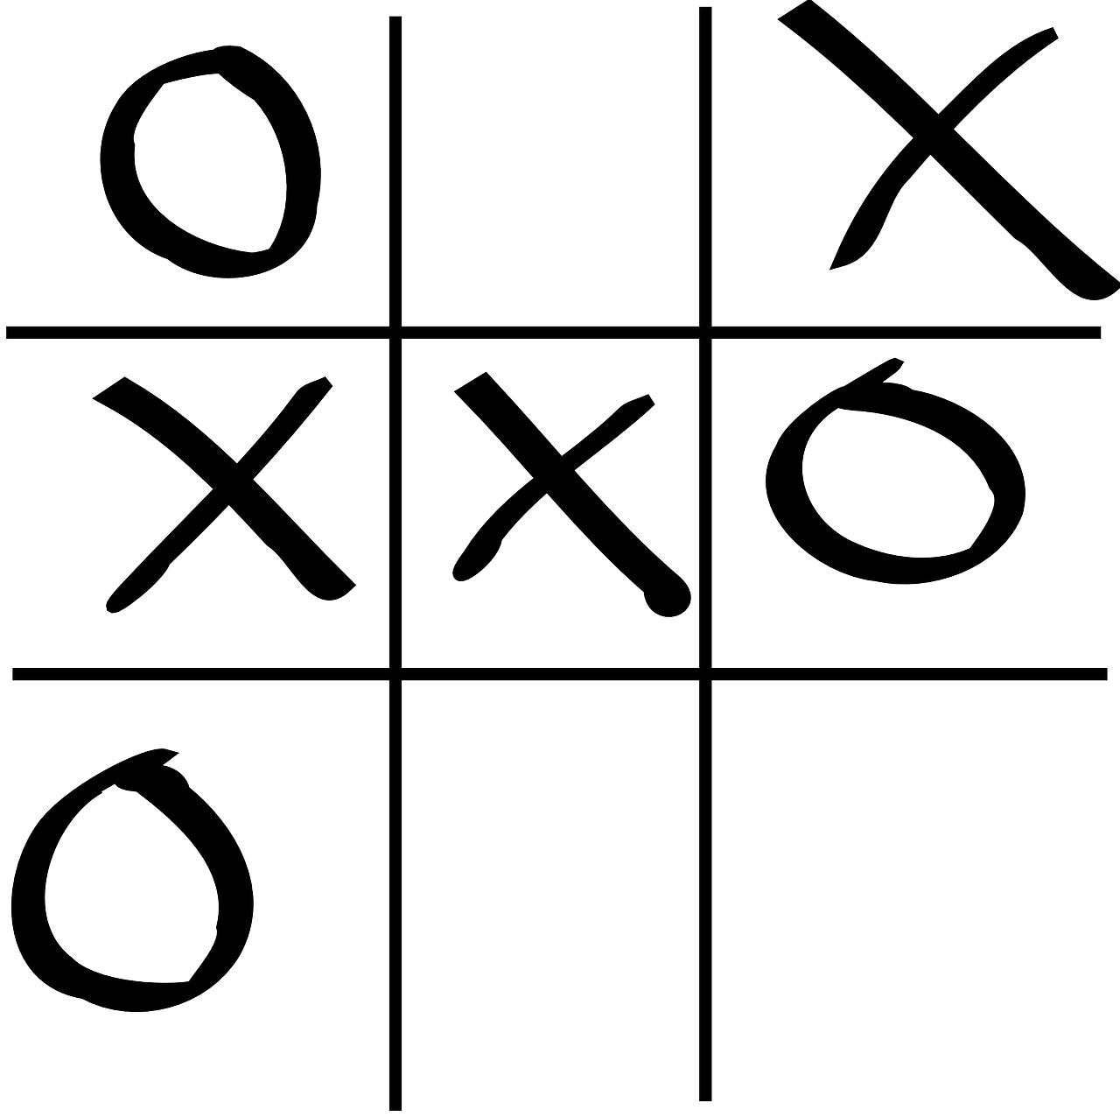
Summary
Creating a Tic Tac Toe game using Java GUI offers a delightful and instructive journey, enhancing cognitive abilities through enjoyable engagement. The process not only fosters entertainment but also serves as a valuable learning experience. The game's uncomplicated design makes it an excellent entry point for those eager to explore game development or delve into cutting-edge technologies within the realm of computer science.

